Slide 1
Connecting QTP to QC/ALM

Slide 2
Connecting QTP to QC (1 of 6)
To work with business process tests, QuickTest must be connected to the QC server
on which the QC project is stored. The connection process has two stages:
Connect QuickTest to a local or remote QC server. This server handles the connections between QuickTest and the QC project.
Log in and choose the project QuickTest is to access. The project stores tests and runs session information for the AUT. Note that QC projects are password protected, so provide your user name and password.
Before QTP can create and save BPT files into QC, the QuickTest Professional for Business Process Testing Add-in must be installed. The add-in can be found on the QC Add-Ins page.
Note: The functionality provided by the QuickTest Professional for Business Process Testing Add-in is included in the QuickTest Add-in for Quality Center that is installed with QTP. If you have already installed QTP on your QC client machine, you do not need to install this add-in.
2

Slide 3
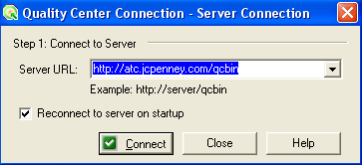
Connecting QTP to QC (2 of 6)
Select File > Quality Center Connection or click the Quality Center Connection toolbar button. The Quality Center Connection - Server Connection dialog box opens.
To automatically reconnect to the QC server the next time QuickTest is opened, select the Reconnect to server on startup check box.
3

Slide 4
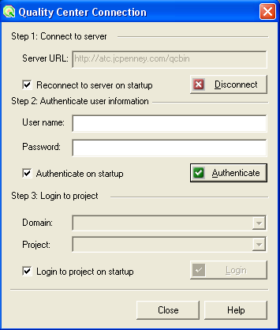
Connecting QTP to QC (3 of 6)
Click Connect. The Quality Center Connection dialog box opens.
4

Slide 5
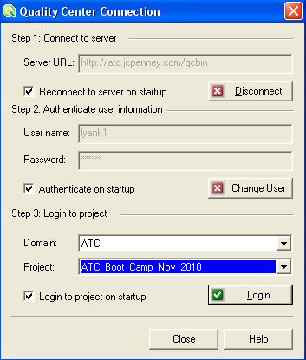
Connecting QTP to QC (4 of 6)
In the User name box, type your QC User name.
In the Password box, type your QC Password.
Click Authenticate to authenticate your user information against the QC server. After the user information is authenticated, the edit boxes in the Authenticate user information area are displayed in read-only format. The Authenticate button changes to a Change User button.
5

Slide 6
Connecting QTP to QC (5 of 6)
In the Domain box, select the domain that contains the QC project. Only those domains that you have permission to connect to are displayed.
In the Project box, select the desired project. Only those projects for which you are a defined user are displayed.
Click Login.
6

Slide 7
Connecting QTP to QC (6 of 6)
QTP then connects to QC.
Click Close to close the Quality Center Connection dialog box. The Quality Center icon is displayed on the status bar to indicate that QuickTest is currently connected to a Quality Center project.
Tip: To view the current Quality Center connection, point to the Quality Center icon on the status bar. A tooltip displays the Quality Center server name and project to which QuickTest is connected. To open the Quality Center Connection dialog box, double-click the Quality Center icon.
7

Slide 8
Demo : Connect QTP to QC
Launch QTP.
Connect to the Training Quality Center project.
8

